Slide 1
React.js
Building React Apps with Flux
Notes:
Add instructor notes here.

Slide 2
Lesson Objectives
At the end of this module you will be able to:
Explain and demonstrate
How to use Modules in Node.js
How to create an Event Emitter in Node.js
How to create Gulp tasks
How to perform Routing in React.js
Describe the Flux pattern and its components
Notes:
Add instructor notes here.

Slide 3
Building React Apps with Flux Introduction to Node.js
Node.js is a platform built on Chrome’s JavaScript runtime (v8 JavaScript Engine) that aids in building fast, scalable network applications.
It is written in C++ and JavaScript.
JavaScript can be executed in server side using the node platform which promotes JavaScript to run on the Server-side as well as Client-side.
Node adapts JavaScript's non-blocking event loop and makes itself a highly scalable system that uses asynchronous, non-blocking I/O model.
Notes:
Node.js CLI
Add instructor notes here.

Slide 4
Building React Apps with Flux Modules in Node.js
A module encapsulates related code into a single unit of code.
It avoids collision of the methods/variables with other global APIs.
In Node, modules are referenced either by file path or by name.
To work with modules there are three key components:
require(): It is used to import the module.
exports & module.exports: It is used to expose any JavaScript objects from one JavaScript file which can be used in other files. Here exports collect all the properties and finally attach them to module.exports.
Notes:
Modules can be referenced depending on which kind of module it is.
Loading a core module
Node has several modules compiled into its binary distribution. These are called the core modules. It is referred solely by the module name, not by the path and are preferentially loaded even if a third-party module exists with the same name.
var http = require('http');
Loading a file module (User defined module)
We can load non-core modules by providing the absolute path / relative path. Node will automatically adding the .js extension to the module referred.
// Absolute path for module.js
var myModule = require('d:/karthik/nodejs/module');
// Relative path for module.js (one folder up level)
var myModule = require('../module');
// Relative path for module.js (Exists in current directory)
var myModule = require('./module');
Loading a folder module (User defined module)
We can use the path for a folder to load a module.
var myModule = require('./myModuleDir');
Add instructor notes here.

Slide 5
Demo
Module-Demo
Notes:
Creating and exporting a module
Creating a module that exposes / exports a function called helloWorld.
exports object is a special object created by the Node module system which is returned as the value of the require function when you include that module.
Consuming the function on the exports object created in myModule.js
We can replace exports with module.exports
exports = module.exports = { }
Add instructor notes here.
// Save it as myModule.js
exports.helloWorld = function () {
console.log("Hello World");
}
// Save it as moduleTest.js
var module = require('./myModule'); module.helloWorld();

Slide 6
Building React Apps with Flux Node Package Manager
Apart from writing our own modules and node core modules, we will frequently use the modules written by other people in the Node community and published on the Internet (npmjs.com).
We can install those third party modules using the Node Package Manager which is installed by default with the node installation.
To install modules via npm use npm install command. Ex:- npm install gulp
npm installs module packages to the node_modules folder.
If the module name is not relative and is not a core module, Node will try to find it inside the node_modules folder in the current directory.
var gulp = require('gulp'); //gulp is a third party module
Notes:
Loading modules
Modules can be referenced depending on which kind of module it is.
Loading a core module
Node has several modules compiled into its binary distribution. These are called the core modules. It is referred solely by the module name, not by the path and are preferentially loaded even if a third-party module exists with the same name.
var http = require('http');
Loading a file module (User defined module)
We can load non-core modules by providing the absolute path / relative path. Node will automatically adding the .js extension to the module referred.
// Absolute path for module.js
var myModule = require('d:/karthik/nodejs/module');
// Relative path for module.js (one folder up level)
var myModule = require('../module');
// Relative path for module.js (Exists in current directory)
var myModule = require('./module');
Loading a folder module (User defined module)
We can use the path for a folder to load a module.
var myModule = require('./myModuleDir');
Add instructor notes here.

Slide 7
Building React Apps with Flux EventEmitter
In node.js an event can be described simply as a string with a corresponding callback and it can be emitted.
The on or addListener method allows us to subscribe the callback to the event.
The emit method "emits" event, which causes the callbacks registered to the event to trigger.
var events = require('events');
var eventEmitter = new events.EventEmitter();
var myCallback = function(data) {
console.log('Got data: '+data);
};
eventEmitter.on('karthikEvent', myCallback);
var fn = function() {
eventEmitter.emit('karthikEvent','Data from Emitter');
};
fn();
Notes:
EventEmitter Methods
All objects which emit events in node are instances of events.EventEmitter which is available inside Event module.
We can access the Event module using require("events")
addListener(event, listener) / on(event, listener)
Adds a listener to the end of the listeners array for the specified event. Where listener is a function which needs to be executed when an event is emitted.
once(event, listener)
Adds a one time listener for the event. This listener is invoked only the next time the event is fired, after which it is removed.
removeListener(event, listener)
Remove a listener from the listener array for the specified event
removeAllListeners([event])
Removes all listeners, or those of the specified event
Add instructor notes here.

Slide 8
Building React Apps with Flux Creating an EventEmitter
We can create Event Emitter pattern by creating a constructor function / pseudo-class and inheriting from the EventEmitter.
var EventEmitter = require('events').EventEmitter,
util = require('util');
var Foo = function(){ }
util.inherits(Foo, EventEmitter);
Foo.prototype.someMethod = function() {
this.emit('customEvent', 'Data from Some Method');
}
var fooObj = new Foo();
fooObj.on('customEvent',function(arg){
console.log('Custom Event Occurred : '+arg);
});
fooObj.someMethod();
Notes:
Add instructor notes here.

Slide 9
Demo
EventEmitter
Notes:
Add instructor notes here.

Slide 10
Building React Apps with Flux Gulp – JavaScript Task Runner
Gulp is a JavaScript task runner
Gulp's use of streams and code-over-configuration makes for a simpler and more intuitive build.
Gulp is a streaming build system that uses node streams, wherein all the file manipulation is done in the memory; thus, a file is not written until the developer/programmer commands it to do so.
Gulp is easy to get installed and running. The steps to install and run Gulp are:
Install Gulp Globally: npm install -g gulp
Install Gulp In devDependencies: npm install --save-dev gulp
Optionally install package Gulp-Util log the message in console: npm install gulp-util
Create a gulpfile.js
Packages required to work with React are: gulp-browserify, gulp-concat, react, react-dom, reactify
Notes:
gulp-browserify: Browserify lets you require('modules') in the browser by bundling up all of your dependencies.
gulp-concat: Used to concatenate files
react : React is a JavaScript library for building user interfaces. It gives immediate access to React, without requiring the JSX transformer
react-dom : React package for working with the DOM.
reactify : Browserify transform for JSX
Add instructor notes here.

Slide 11
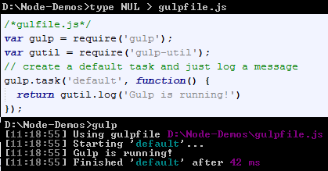
Building React Apps with Flux Gulp API
The gulp API is incredibly light containing the following top level functions:
gulp.task: It is used to define the tasks.
gulp.src: It is the beginning of the stream which points to the files we want to use. It uses .pipe for chaining it’s output into other plugins.
gulp.dest: It points to the output folder we want to write files to.
gulp.watch: It allows us to watch files and then performs a task or function.
Notes:
gulp.task : It takes three arguments are name, deps and fn. Where name is a string, deps is an array of task names which makes the task given to run once all task mentioned in deps is completed, and fn is the function that performs your task.
gulp.src and gulp.dest : mostly used to copy files.
gulp.watch: To watch files.
Add instructor notes here.
gulp.task('mytask', function() {
//do stuff
});
gulp.task('dependenttask', ['mytask'], function() {
//do stuff after 'mytask' is done.
});
/*watch for text files in any sbu folders of src for changes*/
gulp.task('watchTxtFiles',function(){
gulp.watch('./src/**/*.txt',function(event){
gutil.log('path : '+event.path+':'+event.type);
});
});
gulp.task('copyTxtFiles', function() {
// copy any txt files in src and its sub folders to public/
gulp.src('./src/**/*.txt').pipe(gulp.dest('public'));
});

Slide 12
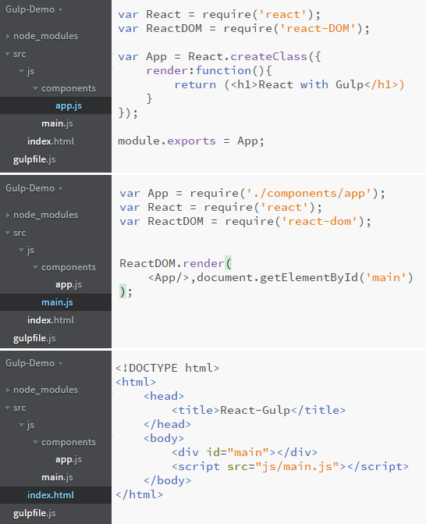
Building React Apps with Flux Creating React Component modules
app.js
main.js
index.html
Notes:
Add instructor notes here.

Slide 13
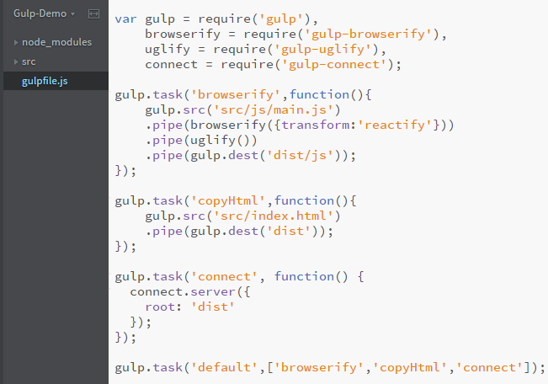
Building React Apps with Flux Creating gulpfile.js
Notes:
Add instructor notes here.

Slide 14
Demo
Gulp-Demo
Notes:
Add instructor notes here.

Slide 15
Building React Apps with Flux React-Routing
React isn't a framework, it's a library. Therefore, it doesn't solve all an application's needs.
To create complex SPA (single page application) task like routing requires supporting cast.
React router is one among the front-end router which uses JSX Syntax.
To install this module : npm install react-router
React router uses <Router> and <Route> components to perform routing.
Like other components <Router> and <Route> does not create DOM, it just defines the rules about how application needs to work based on routes.
ReactDOM.render(( <Router>
//<Route> Renders Home component while vising the path /
<Route path="/" component={Home} />
</Router> ), document.getElementById('app'));
Notes:
Each <Route>will render its respective component when its path matches the URL. Only one of these three components will be rendered into the at any given time. With this strategy, we mount the router to the DOM once, then the router swap components in and out with route changes.
Route Matching:
<Route path="users/:userId" component={UserProfile} />
The above route will match when the user visits any path that starts with users/ and has any value afterwards. It will match /users/1, /users/143, or even /users/abd(which you'll need to be validated on our own).
Add instructor notes here.
var React = require('react');
var ReactDOM = require('react-dom');
var ReactRouter = require('react-router'); // require react-router module
var Router = ReactRouter.Router; // Get Router Reference
var Route = ReactRouter.Route; //Get Route Reference
ReactDOM.render((
<Router>
<Route path="/" component={Home} />
<Route path="/about" component={AboutUs} />
<Route path="/contact" component={ContactUs} />
</Router>
), document.getElementById('app'));

Slide 16
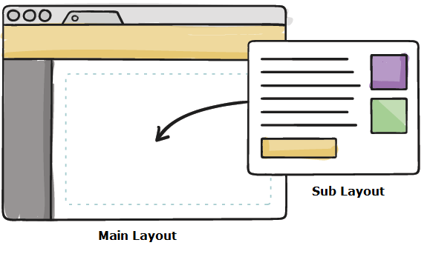
Building React Apps with Flux Re-Usable layout
In the diagram Sub Layout is placed inside its Parent Main Layout.
Main Layout will use this.props.children to determine Sub Layout location.
All components have this.props.children as a prop, which gets filled only when if it is a parent component nested with child components.
If the component is not a parent component this.props.children will be null.
Components will be nested in accordance with how the router nests its router.
When creating anchors for routes, use <Link to="" > instead of <a href="">
Notes:
Note : React Router recommends a wildcard router on the server-side. With this strategy, no matter what server-side route is called, the server should always serve the same HTML file. Then if the user starts directly at , even though the same HTML file is returned, React Router is smart enough to load the correct component.
Add instructor notes here.
<Router >
<Route path="/" component={App}>
<IndexRoute component={Index}/>
<Route path="about" component={About}/>
//Any other path other than specified show Error Page
<Route path="*" component={Error}/>
</Route>
</Router>, document.getElementById('app'));
var App = React.createClass({
render:function(){
return (
<div>
<Header/>
//this.props.children can be filled by Component Index, About, Error
<div> {this.props.children} </div>
</div>
);
}
});

Slide 17
Demo
Router-Demo
Notes:
Add instructor notes here.

Slide 18
Building React Apps with Flux Flux Introduction
Most of the state will go to the top-level component and take data using setData function and pass it down in the tree as props which makes root component tends to grow in terms of code and complexity.
Flux provides the solution for the above mentioned issue through its four major components: Stores, Dispatchers, Views / Components, and Actions.
Flux is not a framework, it is a pattern which supports unidirectional data flow.
Action
Dispatcher
Store
React View
Action
Notes:
Stores are used to keep data any component can register to the store. When data in the store updates, all registered components gets new version of data from the store. Components gets data from stores and emits actions, which updates stores. Dispatcher dispatch Actions.
Add instructor notes here.

Slide 19
Building React Apps with Flux Flux - Action
Actions (payload) contain no functionality, but rather it describes an event in the application.
Action encapsulates events that occur within the application like Add User, Delete Item etc.
Actions can be triggered in two different ways:
When user interacts with user interface, view will call appropriate actions.
From the server such as page load or when the error occurred during calls to the server.
Payload is typically synonymous with an action. Payload has type and data.
{ type : CREATE_USER, user : {id : 1, name :'AnilPatil' } }
Notes:
Add instructor notes here.

Slide 20
Building React Apps with Flux Flux - Dispatcher
The dispatcher is a singleton, and operates as the central hub of data flow in a Flux application.
Dispatchers are essentially a registry of callbacks, which can invoke these callbacks in order.
Dispatchers receive actions and dispatch it to its listeners.
Dispatcher sends actions to the store.
An application can have only one dispatcher.
Notes:
A dispatcher emits events (.dispatch()) to its listeners (.register(fn)).
To ensure proper order of execution with multiple listeners, use .waitFor() to ensure one is fired after another.
Add instructor notes here.

Slide 21
Building React Apps with Flux Flux - Store
Store are the place where the application data is stored.
Store hold application state, logic, and data retrieval methods.
Store are not a model, in fact it contains model.
An application can have one or many stores.
Store register callbacks with the dispatcher.
As a best practice only stores should register dispatcher callbacks, React components should never register callback with the dispatcher directly.
Notes:
Add instructor notes here.

Slide 22
Building React Apps with Flux Flux - Store
Stores has no direct setter method, they only accept updates via callbacks.
Stores emits changes using Node's EventEmitter.
In Flux application stores are the only stakeholders that know how to update data.
Every store has the following common interface -
Extends Event Emitter, addChangeListener / removeChangeListener and emitChange
Notes:
Add instructor notes here.

Slide 23
Building React Apps with Flux React View (Controller View)
Top level component in React is also called as Controller View because it controls the flow of data down to all of its child components.
Controller Views are used to interact with stores; for instance, if a store emits an update, the controller view should receive the update and pass the updated data to its child components.
As a best practice top level component should -
Interact with the store
Hold the data in its state
Pass all the necessary data down to its children via props
Notes:
Add instructor notes here.

Slide 24
Building React Apps with Flux Flux flow
Action
Web API
Action makes Ajax calls to Web API to Send / receive data
User clicked Save button
Send Action Payload
Payload send to dispatcher
Checks for the registered callbacks to determine which store to receive payload
Dispatcher
Store updates it's internal storage based on the payload it had received
Send Action Payload
Store
Receive the change and render the view
Update storage and fires change event
Sends payload to all the stores which registered the callback
React View
Store updates and emit change event to notify React view
Notes:
Action Flow :
When user click's the Save button in the React component
Action register's an action creator with the dispatcher, so that the dispatcher will notify all the registered stores.
Dispatcher send the payload to the store based on the callback registration.
Store update the payload sent by dispatcher and emit an change event to notify the React Top-level component.
React Controller View update the UI with the new data from the store
Add instructor notes here.

Slide 25
Demo
Flux-Demo
Notes:
Add instructor notes here.

Slide 26
Summary
In this module you learnt that:
JavaScript can be executed in server side using the node platform which promotes JavaScript to run every where.
A module encapsulates related code into a single unit of code.
module.exports is used to expose any JavaScript objects from one JavaScript file to another one.
We can access the module using require(“modulefile”).
All objects which emit events in node are instances of events.EventEmitter which is available inside Event module.
Gulp is a JavaScript task runner which make use of streams and code-over-configuration.
Gulp task must be created in a file named “gulpfile.js”.
Flux is not a framework, it is a pattern.
Notes:
Add the notes here.
Add instructor notes here.

